Slide 1
CS2100 Tutorial 11
Cache
While waiting, do fill the end-of-sem feedback
https://blue.nus.edu.sg
Slides by Theodore, adapted from Prof. Aaron’s slides

Slide 2
Recap
Types of cahces
direct mapped cache
n-way associative
fully associative

Slide 3
Overview
Q1) Control values
Q2) Critical path / time calculation
Q3) Messing up inputs and hypotheticals

Slide 4
Q1a
Info from question:
Machine is byte-addressable
Word size is 16 bits (2 bytes)
Address space spanned by 32 bits
Cache:
16 blocks
2 word in a block

Slide 5
Q1a
Valid words:
0x00
0x02
0x04
…
Invalid words (but valid address):
0x01
0x03
0x05
…
Info from question:
Machine is byte-addressable
Word size is 16 bits (2 bytes)
Address space spanned by 32 bits
Cache:
16 blocks
2 words in a block
16 blocks: index of size 4

Slide 6
Q1a
Info from question:
Machine is byte-addressable
Word size is 2 bytes → last bit needs to be 0 for a valid word
Address space spanned by 32 bits
Cache:
16 blocks → index size 4
2 words in a block
Example address: 0b0000 0000 0000 0000 0000 0000 0000 0000

Slide 7
Q1a
Info from question:
Machine is byte-addressable
Word size is 2 bytes → last bit needs to be 0 for a valid word
Address space spanned by 32 bits
Cache:
16 blocks → index size 4
2 words in a block
Example address: 0b0000 0000 0000 0000 0000 0000 0000 0000

Slide 8
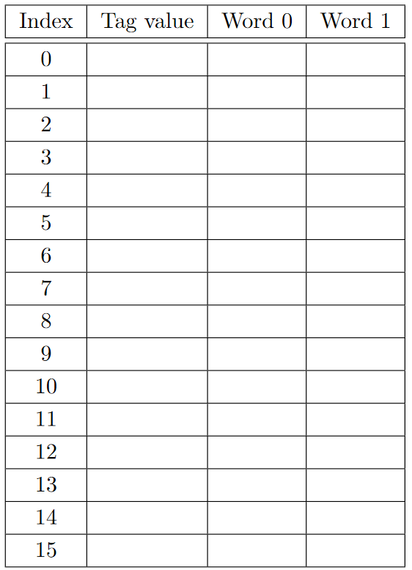
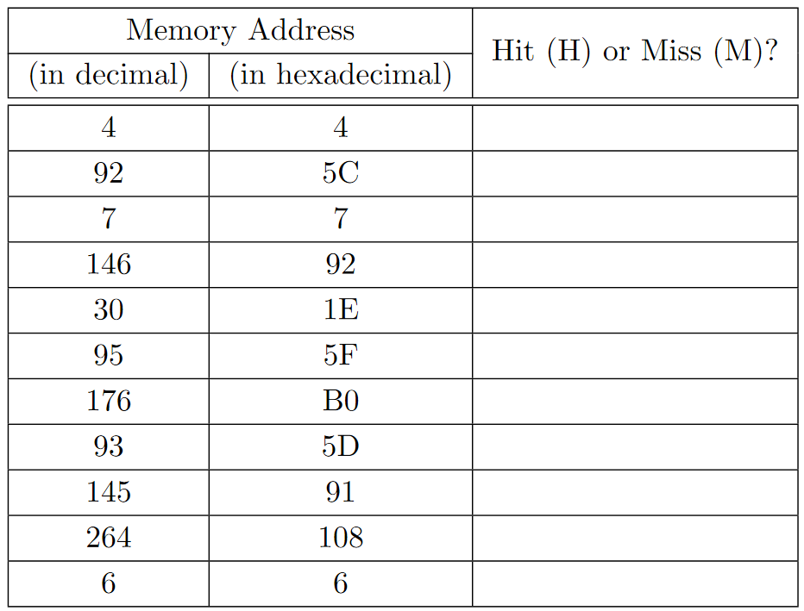
Q1a

Slide 9
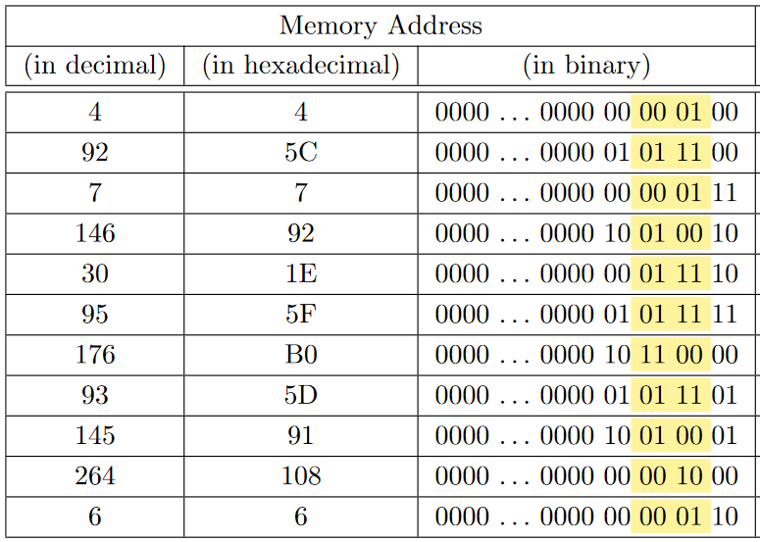
Q1a

Slide 10
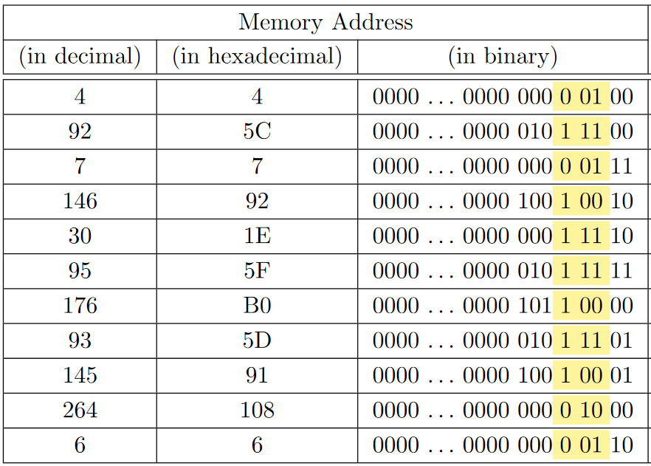
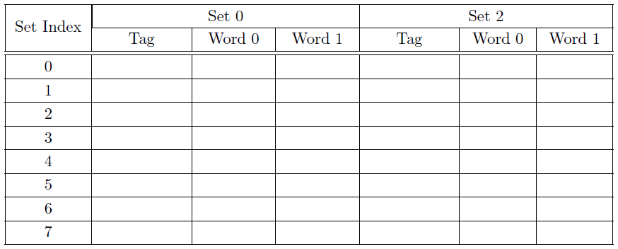
Q1b

Slide 11
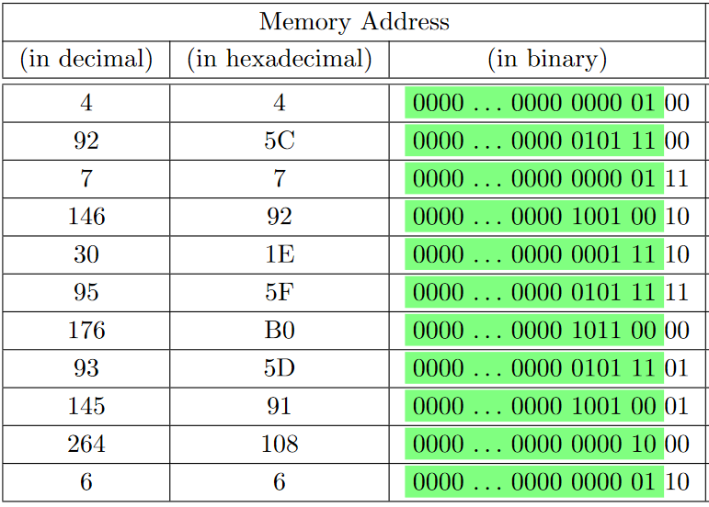
Q1a

Slide 12
Q2
MIPS
Addresses are 32 btis
Words are 4 bytes each
→ consecutive words differ by 4 in their address
→ all words' addresses end with 00
4 blocks in cache, 2 words each
→ 1 bit to distinguish the different words
→ 2 bits for index
0b0000 0000 0000 0000 0000 0000 0000 0000
start:
la $s0, A #PC=0x100
la $s1, B #PC=0x104
li $t0, 1 #PC=0x108
loop:
slt $t1, $t0, 1000 #PC=0x10c
beq $t1, $zero, endl #PC=0x110
sll $t2, $t0, 2 #PC=0x114
add $t3, $s0, $t2 #PC=0x118
lw $a0, 0($t3) #PC=0x11c
add $t4, $s1, $t2 #PC=0x120
lw $a1, 0($t4) #PC=0x124
add $v0, $a0, $a1 #PC=0x128
sw $v0, -4($t3) #PC=0x12c
addi $t0, $t0, 1 #PC=0x130
j loop #PC=0x134
endl:
Index | Tag | Word 1 | Word 2
0
1
2
3

Slide 13
Q2
$t0 starts at 1; $t2 = $t0 x 4
$t3 = $s0 + $t2
→ first lw is on memory 0x1000 + 4 = 0x1004
$t4 = $s1 + $t2
→ second lw is on memory 0x4010 + 4 = 0x4014
And first sw is on $t3 – 4
→ 0x1004 – 4 = 0x1000
At the end of iteration, $t0++.
start:
la $s0, A #PC=0x100
la $s1, B #PC=0x104
li $t0, 1 #PC=0x108
loop:
slt $t1, $t0, 1000 #PC=0x10c
beq $t1, $zero, endl #PC=0x110
sll $t2, $t0, 2 #PC=0x114
add $t3, $s0, $t2 #PC=0x118
lw $a0, 0($t3) #PC=0x11c
add $t4, $s1, $t2 #PC=0x120
lw $a1, 0($t4) #PC=0x124
add $v0, $a0, $a1 #PC=0x128
sw $v0, -4($t3) #PC=0x12c
addi $t0, $t0, 1 #PC=0x130
j loop #PC=0x134
endl:
Index | Tag | Word 1 | Word 2
0
1
2
3

Slide 14
Q2
$t0 starts at 1; $t2 = $t0 x 4
$t3 = $s0 + $t2
→ first lw is on memory 0x1000 + 4 = 0x1004
$t4 = $s1 + $t2
→ second lw is on memory 0x4010 + 4 = 0x4014
And first sw is on $t3 – 4
→ 0x1004 – 4 = 0x1000
At the end of iteration, $t0++.
start:
la $s0, A #PC=0x100
la $s1, B #PC=0x104
li $t0, 1 #PC=0x108
loop:
slt $t1, $t0, 1000 #PC=0x10c
beq $t1, $zero, endl #PC=0x110
sll $t2, $t0, 2 #PC=0x114
add $t3, $s0, $t2 #PC=0x118
lw $a0, 0($t3) #PC=0x11c
add $t4, $s1, $t2 #PC=0x120
lw $a1, 0($t4) #PC=0x124
add $v0, $a0, $a1 #PC=0x128
sw $v0, -4($t3) #PC=0x12c
addi $t0, $t0, 1 #PC=0x130
j loop #PC=0x134
endl:
Index | Tag | Word 0 | Word 1
0 | 0x0…0080 | M[1000] | M[1004]
1
2 | 0x0…0200 | M[4010] | M[4014]
3

Slide 15









Q2
$t0 starts at 1; $t2 = $t0 x 4
$t3 = $s0 + $t2
→ first lw is on memory 0x1000 + 4 = 0x1004
$t4 = $s1 + $t2
→ second lw is on memory 0x4010 + 4 = 0x4014
And first sw is on $t3 – 4
→ 0x1004 – 4 = 0x1000
At the end of iteration, $t0++.
start:
la $s0, A #PC=0x100
la $s1, B #PC=0x104
li $t0, 1 #PC=0x108
loop:
slt $t1, $t0, 1000 #PC=0x10c
beq $t1, $zero, endl #PC=0x110
sll $t2, $t0, 2 #PC=0x114
add $t3, $s0, $t2 #PC=0x118
lw $a0, 0($t3) #PC=0x11c
add $t4, $s1, $t2 #PC=0x120
lw $a1, 0($t4) #PC=0x124
add $v0, $a0, $a1 #PC=0x128
sw $v0, -4($t3) #PC=0x12c
addi $t0, $t0, 1 #PC=0x130
j loop #PC=0x134
endl:
Index | Tag | Word 0 | Word 1
0 | 0x0…0080 | M[1000] | M[1004]
1
2 | 0x0…0200 | M[4010] | M[4014]
3

Slide 16
Q2
$t0 starts at 1; $t2 = $t0 x 4
$t3 = $s0 + $t2
→ first lw is on memory 0x1000 + 4 = 0x1004
$t4 = $s1 + $t2
→ second lw is on memory 0x4010 + 4 = 0x4014
And first sw is on $t3 – 4
→ 0x1004 – 4 = 0x1000
At the end of iteration, $t0++.
start:
la $s0, A #PC=0x100
la $s1, B #PC=0x104
li $t0, 1 #PC=0x108
loop:
slt $t1, $t0, 1000 #PC=0x10c
beq $t1, $zero, endl #PC=0x110
sll $t2, $t0, 2 #PC=0x114
add $t3, $s0, $t2 #PC=0x118
lw $a0, 0($t3) #PC=0x11c
add $t4, $s1, $t2 #PC=0x120
lw $a1, 0($t4) #PC=0x124
add $v0, $a0, $a1 #PC=0x128
sw $v0, -4($t3) #PC=0x12c
addi $t0, $t0, 1 #PC=0x130
j loop #PC=0x134
endl:
Index | Tag | Word 0 | Word 1
0 | 0x0…0080 | M[1000] | M[1004]
1
2 | 0x0…0200 | M[4010] | M[4014]
3

Slide 17
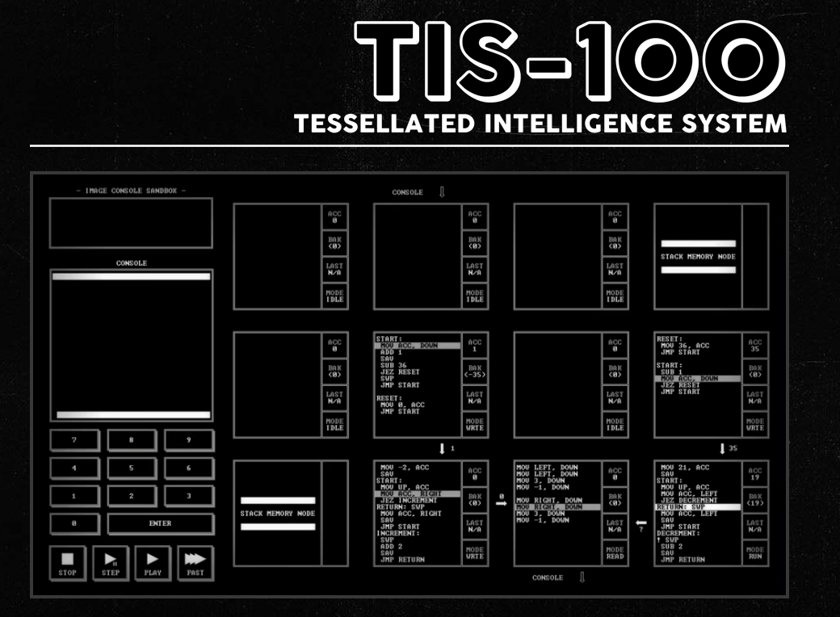
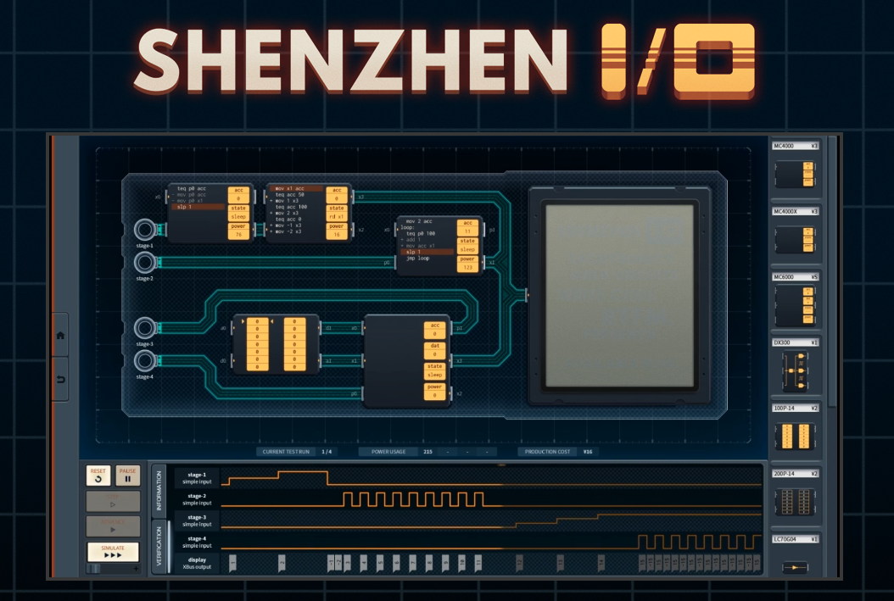

Bonus: Beyond CS2100
MIPS
Was and is used for some microprocessors
Current: Loongson / LoongArch is MIPS-compatible
Numerous other architectures besides MIPS! x86/x86-64, ARM/Arm-64, RISC V, …
If you’re interested in more assembly stuff:
CS4212 Compiler Design – you’ll make your own C to x86-lite compiler
CS2106 and some CEG Courses
A bunch of assembly games (check them out on Steam) (not sponsored or endorsed by me)

Slide 18
Bonus: Beyond CS2100
Logic Circuit
Not going to see this much if you’re taking CS
If interested in this – look into CG / EE-coded courses; may be able to audit
Caching
If you are going to take CS2106 (Operating Systems), you will see something really similar under the Paging topic
Idea is the same -- put data somewhere fast if you access it multiple times
More replacement policies beyond LRU

Slide 19

End of Tutorial 11
Slides uploaded on github.com/theodoreleebrant/TA-2425S1
Email: theo@comp.nus.edu.sg
Anonymous feedback:
bit.ly/feedback-theodore
(or scan on the right)
All the best for exams!
(Also reminder for me to take attendance)

